Slide 1
Software Evolution and Maintenance
A Practitioner’s Approach
Chapter 7
Refactoring
Notes:
Handouts
------------------------------------------------------------------
------------------------------------------------------------------
-------------------------------------------------------------------
--------------------------------------------------------------------

Slide 2
Outline of the Chapter
7.1 General Idea
7.2 Activities in a Refactoring Process
7.3 Formalisms for Refactoring
7.4 More Examples of Refactoring
7.5 Initial Work on Software Restructuring
7.6 Summary
Notes:
Handouts

Slide 3
7.1 General Idea
Developers continuously modify, enhance and adapt software.
As software evolves and strays away from its original design, three things happen.
  Decreased understandability
  Decreased reliability
  Increased maintenance cost
Decreased understandability is due to
  Increased complexity of code
  Out-of-date documentation
  Code not conforming to standards
Notes:
Handouts

Slide 4
7.1 General Idea
Decrease the complexity of software by improving its internal quality by restructuring the software.
Restructuring applied on object-oriented software is called refactoring.
Restructuring means reorganizing software (source code + documentation) to give it a different look, or structure.
Notes:
Handouts

Slide 5
7.1 General Idea
Source code is restructured to improve some of its non-functional requirements:
  Readability
  Extensibility
  Maintainability
  Modularity
Restructuring does not modify the software’s functionalities.
Restructuring can be performed while adding new features.
Notes:
Handouts

Slide 6
7.1 General Idea
Software restructuring is informally stated as the modifications of software to make it
  easier to understand;
  easier to change;
  easier to change its documentation;
  less susceptible to faults when changes are made to it.
Notes:
Handouts

Slide 7
7.1 General Idea
A higher level goal of restructuring is to increase the software value
  external software value: fewer faults in software is seen to be better by customers
  internal software value: a well-structured system is less expensive to maintain
Simple examples of restructuring
  Pretty printing
  Meaningful names for variables
  One statement per line of source code
Notes:
Handouts

Slide 8
7.1 General Idea
Developers and managers need to be aware of restructuring for the following reasons
  better understandability
  keep pace with new structures
  better reliability
  longer lifetime
  automated analysis
Notes:
Handouts

Slide 9
7.1 General Idea
Characteristics of restructuring and refactoring
  The objective of restructuring and refactoring is to improve the internal and external values of software.
  Restructuring preserves the external behavior of the original program.
  Restructuring can be performed without adding new requirements.
  Restructuring generally produces a program in the same language.
    Example: a C program is restructured into another C program.
Notes:
Handouts

Slide 10
7.2 Activities in a Refactoring Process
To restructure a software system, one follows a process with well defined activities.
  Identify what to refactor.
  Determine which refactorings to apply.
  Ensure that refactoring preserves the software’s behavior.
  Apply the refactorings to the chosen entities.
  Evaluate the impacts of the refactorings.
  Maintain consistency.
Notes:
Handouts

Slide 11
7.2.1 Identify what to refactor
The programmer identifies what to refactor from a set of high-level software artifacts.
  source code;
  design documents; and
  requirements documents.
Next, focus on specific portions of the chosen artifact for refactoring.
  Specific modules, functions, classes, methods, and data can be identified for refactoring.
Notes:
Handouts

Slide 12
7.2.1 Identify what to refactor
The concept of code smell is applied to source code to detect what should be refactored.
A code smell is any symptom in source code that possibly indicates a deeper problem.
Examples of code smell are:
  duplicate code;
  long parameter list;
  long methods;
  large classes;
  message chain.
Notes:
Handouts

Slide 13
7.2.1 Identify what to refactor
Entities to be refactored at the design level
  software architecture;
    class diagram;
    statechart diagram; and
    activity diagrams;
  global control flow; and
  database schemas.
Notes:
Handouts

Slide 14
7.2.2 Determine which refactorings to apply
Referring to Figure 7.1, some refactorings are
  R1: Rename method print to process in class PrintServer.
  R2: Rename method print to process in class FileServer. (R1 and R2 are to be done together.)
  R3: Create a superclass Server from PrintServer and FileServer.
  R4: Pull up method accept from PrintServer and FileServer to the superclass Server.
  R5: Move method accept from PrintServer to class Packet, so that data packets themselves will decide what actions to take.
  R6: Move method accept from FileServer to Packet.
  R7: Encapsulate field receiver in Packet so that another class cannot directly access this field.
  R8: Add parameter p of type Packet to method print in PrintServer to print the contents of a packet.
  R9: Add parameter p of type Packet to method save in class FileServer so that the contents of a packet can be printed.
Notes:
Handouts

Slide 15
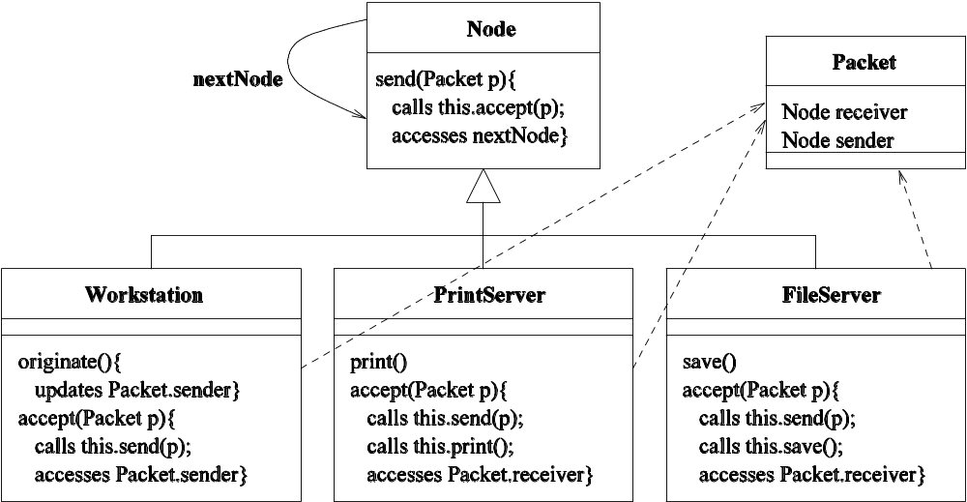
7.2.2 Determine which refactorings to apply.
Figure 7.1: Class diagram of a Local Area Network (LAN) simulator [6]
(©[2007] Springer).

Slide 16
7.2.2 Determine which refactorings to apply
R1—R9 indicate that a large number of refactorings can be identified even for a small system.
A subset of the entire set of refactorings need to be carefully chosen because of the following reasons.
  Some refactorings must be applied together.
    Example: R1 and R2 are to be applied together.
  Some refactorings must be applied in certain orders.
    Example: R1 and R2 must precede R3.
  Some refactorings can be individually applied, but they must follow an order if applied together.
    Example: R1 and R8 can be applied in isolation. However, if both of them are to be applied, then R1 must occur before R8.
  Some refactorings are mutually exclusive.
    Example: R4 and R6 are mutually exclusive.
Notes:
Handouts

Slide 17
7.2.2 Determine which refactorings to apply
Tool support is needed to identify a feasible subset of refactorings.
The following two techniques can be used to analyze a set of refactorings to select a feasible subset.
  Critical pair analysis
    Given a set of refactorings, analyze each pair for conflicts. A apir is said to be conflicting if both of them cannot be applied together.
      Example: R4 and R6 constitute a conflicting pair.
  Sequential dependency analysis
    In order to apply a refactoring, one or more refactorings must be applied before.
    If one refactoring has already been applied, a mutually exclusive refactoring cannot be applied anymore.
      Example: after applying R1, R2, and R3, R4 becomes applicable. Now, if R4 is applied, then R6 is not applicable anymore.
Notes:
Handouts

Slide 18
7.2.3 Ensure that refactoring preserves the software’s behavior.
  Ideally, the input/output behavior of a program after refactoring is the same as the behavior before refactoring.
  In many applications, preservation of non-functional requirements is necessary.
  A non-exclusive list of such non-functional requirements is as follows:
  Temporal constraints: A temporal constraint over a sequence of operations is that the operations occur in a certain order.
    For real-time systems, refactorings should preserve temporal constraints.
  Resource constraints: The software after refactoring does not demand more resources: memory, energy, communication bandwidth, and so on.
  Safety constraints: It is important that the software does not lose its safety properties after refactoring.
Notes:
Handouts

Slide 19
7.2.3 Ensure that refactoring preserves the software’s behavior.
  Two pragmatic ways of showing that refactoring preserves the software’s behavior.
  Testing
    Exhaustively test the software before and after applying refactorings, and compare the observed behavior on a test-by-test basis.
  Verification of preservation of call sequence
    Ensure that the sequence(s) of method calls are preserved in the refactored program.
Notes:
Handouts

Slide 20
7.2.4 Apply the refactorings to chosen entities
The class diagram of Fig. 7.2(a) has been obtained from Fig. 7.1 by
  focusing on the classes FileServer, PrintServer, and Packet; and
  applying refactorings R1, R2, and R3.
Notes:
Handouts

Slide 21
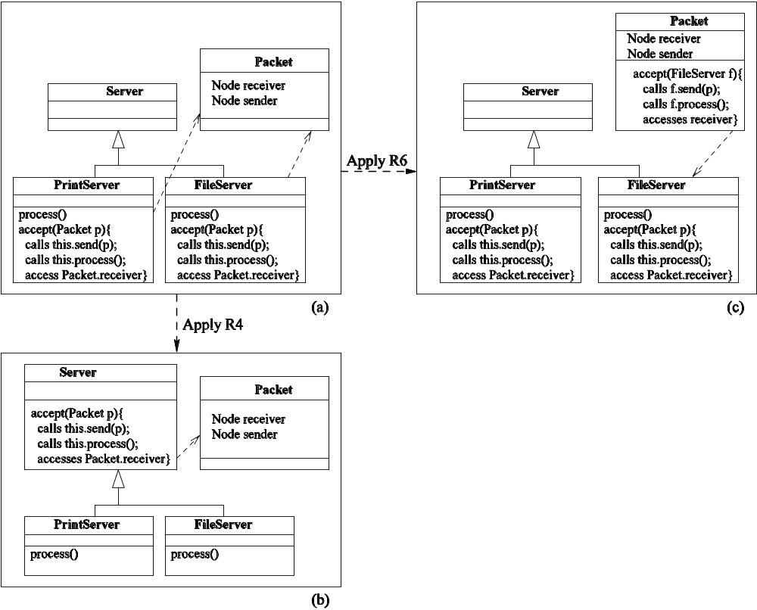
7.2.4 Apply the refactorings to chosen entities
Figure 7.2: Applications of two refactorings [6] (© [2007] Springer).

Slide 22
7.2.5 Evaluate the impacts of the
Refactorings on Quality
Refactorings impact both internal and external qualities of software.
Some examples of internal qualities of software are
  size, complexity, coupling, cohesion, and testability
Some examples of external qualities of software are
  performance, reusability, maintainability, extensibility, robustness, and scalability
Notes:
Handouts

Slide 23
7.2.5 Evaluate the impacts of the
Refactorings on Quality
In general, refactoring techniques are highly specialized, with one technique improving a small number of quality attributes.
For example,
  some refactorings eliminate code duplication;
  some raise reusability;
  some improve performance; and
  some improve maintainability.
Notes:
Handouts

Slide 24
7.2.5 Evaluate the impacts of the
Refactorings on Quality
By measuring the impacts of refactorings on internal qualities, their impacts on external qualities can be measured.
Example of measuring external qualities
  Some examples of software metrics are coupling, cohesion, and size.
  Decreased coupling, increased cohesion, and decreased size are likely to make a software system more maintainable.
  To assess the impact of a refactoring technique for better maintainability, one can evaluate the metrics before refactoring and after refactoring, and compare them.
Notes:
Handouts

Slide 25
7.2.5 Evaluate the impacts of the
Refactorings on Quality
By measuring the impacts of refactorings on internal qualities, their impacts on external qualities can be measured.
Example of measuring external qualities
  Some examples of software metrics are coupling, cohesion, and size.
  Decreased coupling, increased cohesion, and decreased size are likely to make a software system more maintainable.
  To assess the impact of a refactoring technique for better maintainability, one can evaluate the metrics before refactoring and after refactoring, and compare them.
Notes:
Handouts

Slide 26
7.2.6 Maintain consistency
Rather than evaluate the impacts after applying refactorings, one selects refactorings such that the program after refactoring possesses better quality attributes.
The concept of soft-goal graph help select refactorings.
Exmple: A soft-goal graph for quality attribute (maintainability) is a hierarchical graph rooted at the desired change in the attribute, for example, high maintainability.
The internal nodes represent successive refinements of the attribute and are basically the soft goals.
The leaf nodes represent refactoring transformations which contribute positively/negatively to soft-goals which appear above them in the hierarchy.
…. continued on the following slides.
Notes:
Handouts

Slide 27
7.2.6 Maintain consistency
(Continued from the previous slide)
A partial example of a soft goal graph with one leaf node, namely, Move, has been illustrated in Fig. 7.3.
The dotted lines between the leaf node Move and three soft goals – High Modularity, High Module Reuse, and Low Control Flow Coupling imply that the Move transformation impacts those three soft goals.
Notes:
Handouts

Slide 28
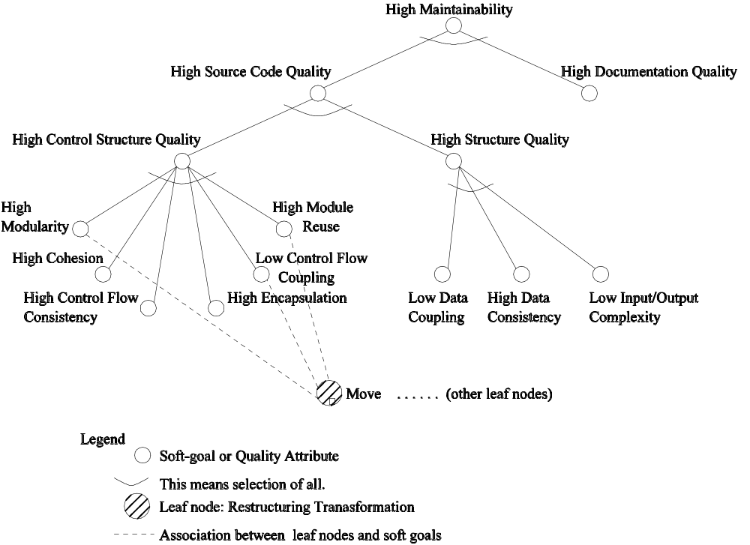
7.2.6 Maintain consistency
Figure 7.3: An example of a soft goal graph for maintainability,
with one leaf node [11] (© [2002] IEEE).

Slide 29
7.3 Formalisms for Refactoring
Three key formalisms for refactoring are:
  assertions:
    Assertions are useful in verifying the assumptions made by programmers.
  graph transformation:
    Graph transformation is useful in viewing refactorings as applications of transformation rules.
  metrics:
    Metrics are useful in quantifying to what extent the internal and external properties of software entities have changed.
Notes:
Handouts

Slide 30
7.3.1 Assertions
Programmers make assumptions about the behavior of programs at specific points, and those assumptions can be tested by means of assertions.
An assertion is specified as a Boolean expression which evaluates to true or false.
Three kinds of assertions:
  invariants;
  preconditions; and
  postconditions.
Notes:
Handouts

Slide 31
7.3.1 Assertions
Invariant
  An invariant is an assertion that evaluates to true wherever in the program it is invoked.
  A class invariant is an invariant that all instances of that class must satisfy.
Precondition
  A precondition is a condition that must be satisfied before a computation is performed.
Postcondition
  A postcondition is a condition that must be satisfied after a computation is performed.
Notes:
Handouts

Slide 32
7.3.1 Assertions
Invariants, preconditions, and postconditions can be applied to test the behavior preserving property of refactorings.
Examples of invariant in the context of transformation of database schema is:
  All instance variables of a class, whether defined or inherited, have distinct names.
  All methods of a class, whether defined or inherited, have distinct names.
Note: Static checking of preconditions, postconditions, and invariants is computationally expensive.
Notes:
Handouts

Slide 33
7.3.2 Graph Transformation
Programs, class diagrams, and statecharts can be viewed as graphs, and refactorings can be viewed as graph production rules.
Classes (C), method signatures (M), block structures (B), variables (V), parameters (P), and expressions (E) are represented by typed nodes in a graph.
The possible relationships among the nodes are:
  method lookup (l); -- inheritance (i);
  membership (m); -- (sub)type (t);
  expression (e); -- actual parameter (ap);
  formal parameter (fp); -- cascaded expression (•);
  call (c); -- variable access (a); and
  update (u).
Notes:
Handouts

Slide 34
7.3.2 Graph Transformation
Figure 7.4 shows an example program graph.
The Push-Down-Method refactoring has been applied to method originate in Fig. 7.4 to obtain a new graph shown in Fig. 7.5.
Notes:
Handouts

Slide 35
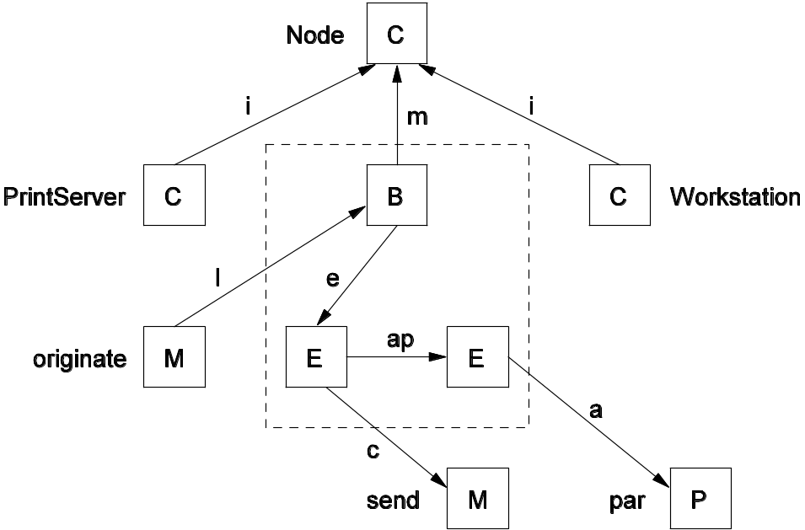
7.3.2 Graph Transformation
Figure 7.4: An example of a program graph [13] (© [2006] Elsevier).

Slide 36
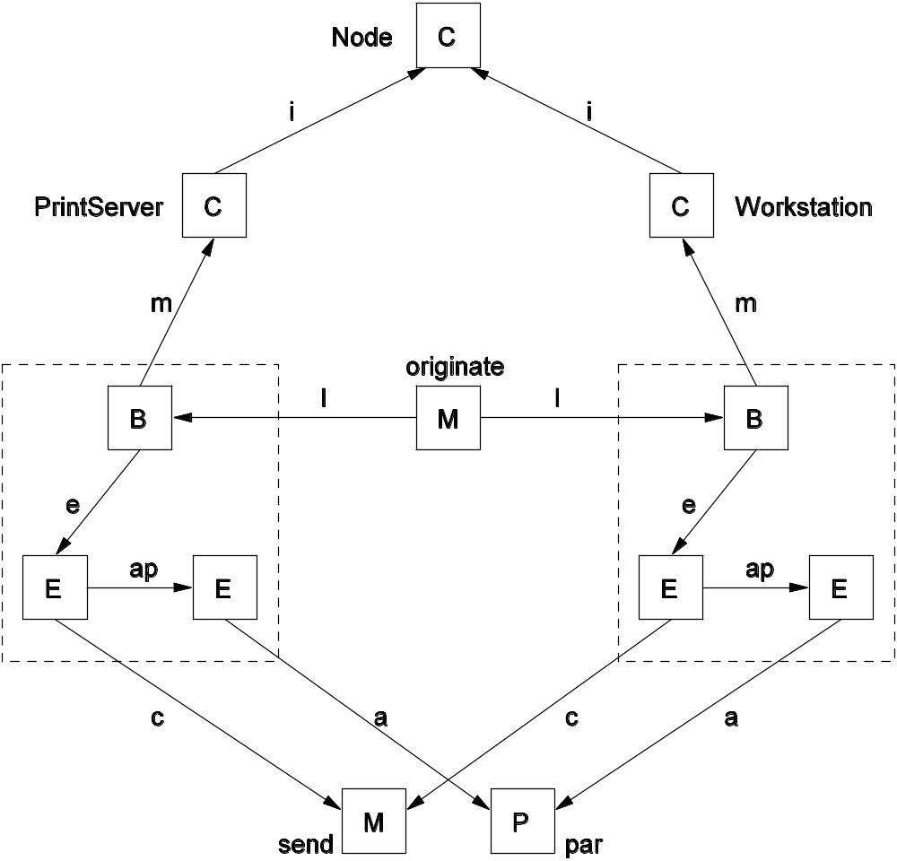
7.3 Formalisms for Refactoring
Figure 7.5: Program graph obtained after applying push-down-method
refactoring to the program graph of Fig. 7.4 [13] (© [2006] Elsevier).

Slide 37
7.3.3 Software Metrics
Software metrics can be used to quantify the internal and external qualities of software.
A module consists of many components; each component provides a defined functionality used by other components.
Measure the strength of togetherness of components within a module to decide whether or not some components should stay in the same module.
Notes:
Handouts

Slide 38
7.3.3 Software Metrics
Two metrics considered are:
  cohesion; and
  coupling.
Cohesion: This metric is used to represent the strength of togetherness in the same module.
Coupling: This metric is used to represent the strength of dependency between separate modules.
Notes:
Handouts

Slide 39
7.4 More Examples of Refactoring
More examples are intuitively explained here.
  Substitute algorithm;
  Replace parameter with methods;
  Push Down Method;
  Parameterize Methods;
Substitute algorithm
  Replace algorithm X with algorithm Y: (i) because implementation of Y is clearer than X; (ii) Y performs better than X; and (iii) standardization bodies want X to be replaced with Y.
  Algorithm substitution is easier if both X and Y have the same input-output behaviors.
Notes:
Handouts

Slide 40
7.4 More Examples of Refactoring
Replace parameters with methods
Consider the following code segment, where the method bodyMassIndex has two formal parameters.
int person;
:
// person is initialized here;
:
int bodyMass = getMass(person);
int height = getHeight(person);
int BMI = bodyMassIndex(bodyMass, height);
:
The above code segment can be rewritten such that the new bodyMassIndex method accepts one formal parameter, namely, person, and internally computes the values of bodyMass and height.
Notes:
Handouts

Slide 41
7.4 More Examples of Refactoring
The refactored code segment has been shown in the following:
int person;
:
// person is initialized here;
:
int BMI = bodyMassIndex(person);
:
The advantage of this refactoring is that it reduces the number of parameters passed to methods.
Such reduction is important because one can easily make errors while passing long parameter lists.
Notes:
Handouts

Slide 42
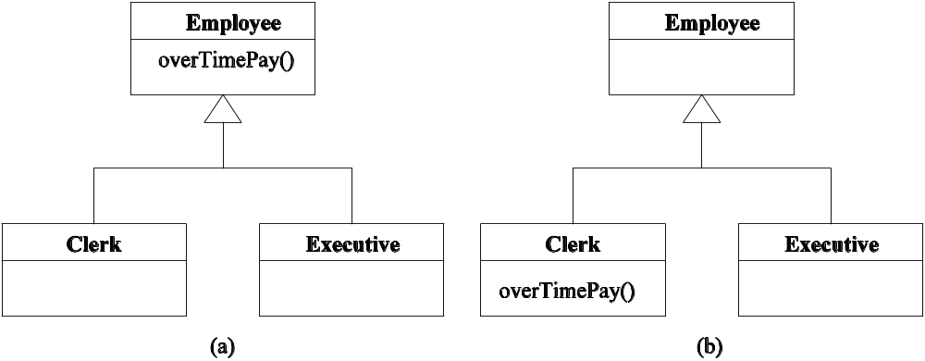
7.4 More Examples of Refactoring
Push Down Method
  Assume that Executive and Clerk are two subclasses of the superclass Employee, as shown in Fig. 7.7(a).
  Method overTimePay has been defined in Employee class.
  If overTimePay is used in the Clerk class, but not in the Executive class, then the programmer can push down overTimePay to the Clerk class, is shown in Fig. 7.7(b).
Figure 7.7: Illustration of the Push Down Method refactoring:
(a) the class diagram before refactoring;
(b) the class diagram after refactoring.
Notes:
Handouts

Slide 43
7.4 More Examples of Refactoring
Parameterize Methods
  Sometimes programmers may find multiple methods performing the same computations on different input data sets.
  Those methods can be replaced with a new method with additional formal parameters, as illustrated in Fig. 7.8.
  In Fig. 7.8(a), we have the Communication class with four methods: bluetoothInterface, wifiInterface, threeGInterface, and fourGInterface.
  In Fig. 7.8(b), we have the Communication class with just one method, namely, wirelessInterface with one parameter, namely, radio.
  The method wirelessInterface can be invoked with different values of radio so that the wirelessInterface method can in turn invoke different radio interfaces.
Notes:
Handouts

Slide 44
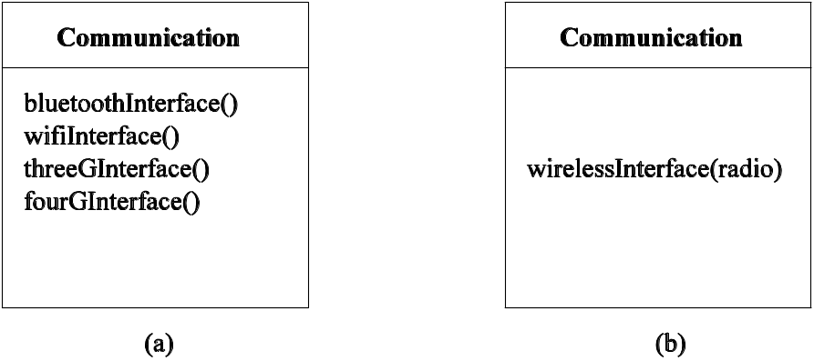
7.4 More Examples of Refactoring
Figure 7.8: An example of parameterizing a method. There are four methods in (a), whereas there is one method in (b) with one parameter.

Slide 45
7.5 Initial Work on Software Restructuring
Software restructuring dates back to the mid 1960s, as soon as programs were written in Fortran.
Topics of discussion in this section are:
  Factors influencing software structure
  Classification of restructuring approaches
  Restructuring techniques
    Elimination-of-goto approach
    Localization and information hiding approach
    System sandwich approach
    Clustering approach
    Program slicing approach
Notes:
Handouts

Slide 46
7.5.1 Factors Influencing Software Structure
Software structure is a set of attributes of the software such that the programmer gets a good understanding of software.
Any factor that can influence the state of software or the programmer’s perception might influence software structure.
One view of the factors that influence software structure has been shown in Fig. 7.9.
  Code -- Documentation
  Tools -- Programmers
  Managers and policies -- Environment
Notes:
Handouts

Slide 47
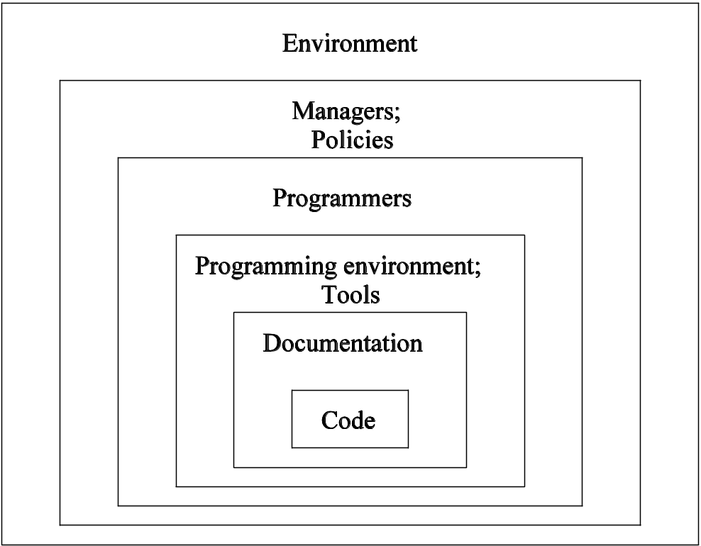
7.5.1 Factors Influencing Software Structure
Figure 7.9: Factors which can influence software structure [2]
(© [1989] IEEE).

Slide 48
7.5.1 Factors Influencing Software Structure
Code
  Code quality at all levels of details (e.g. variables, constants, statements, function, and module) impact code understanding.
  Adherence to coding standards improves code quality.
  Adoption of common architectural styles enhances code understanding.
Documentation
  Internal documentation (also known as in-line codumentation)
  External documentation
    Requirements documents
    Design documents
    User manuals
    Test cases
Notes:
Handouts

Slide 49
7.5.1 Factors Influencing Software Structure
Tools – Programming environment
  Development tools help programmers better understand the code.
    Tracing of source code help in understanding the dynamic behavior of the code.
    Animation of algorithms help in understanding the dynamic strategy adopted in algorithms.
    Cross referencing of global variables reveal interactions among modules.
    Tools can reformat code for better readability via pretty printing, highlighting of key words, and color coding of source code.
Programmers
  Qualities of programmers influence their perception of structure.
  Examples of programmer qualities
    Individual capabilities
    Education
    Experience and training
    Aptitude
Notes:
Handouts

Slide 50
7.5.1 Factors Influencing Software Structure
Managers and policies
  Management can play an influencing role in having a good initial structure and sustain it by designing policies and allocating resources.
  Examples
    Management can design general policies to adhere to standards.
    Management can tie the annual performance review with the programmer’s adherence to standards.
Environment
  This refers to the general working environment of programmers.
  Example: Physical facilities and availability of resources when needed
Notes:
Handouts

Slide 51
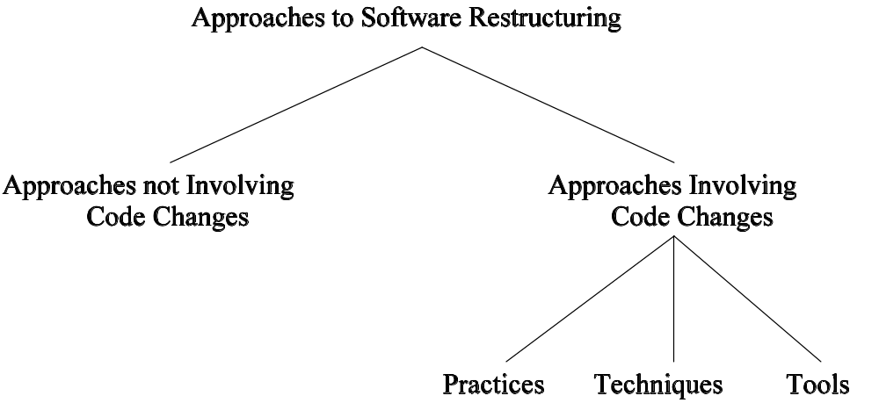
7.5.2 Classification of Restructuring Approaches
A broad classification of software restructuring approaches has been shown in Fig. 7.10.
Figure 7.10: Broad classification of approaches to software structuring.
Notes:
Handouts

Slide 52
7.5.2 Classification of Restructuring Approaches
Approaches not involving code changes
  Train programmers in software engineering, including architectural styles and modularization techniques.
  Upgrade documentation
    Make in-line comments more accurate and readable.
    Update comments to reflect code changes.
    Update external documentations to make them consistent with code, accurate, and complete.
Notes:
Handouts

Slide 53
7.5.2 Classification of Restructuring Approaches
Approaches involving code changes
  Practices: Some examples of restructuring practices are:
    Restructuring code with preprocessors.
    Making code understandable by means of inspection.
    Formatting code by adhering to standards and style guidelines.
    Restructuring code for reusability.
  Techniques: Some approaches are based on defined techniques.
    Incremental restructuring
    Goto-less approach
    Case-statement approach
    Boolean flag approach
    Clustering approach
  Tools
    Eclipse IDE, IntelliJ IDEA, jFactor, Refactorit, and Clone Doctor
Notes:
Handouts

Slide 54
7.5.3 Restructuring Techniques
Restructuring techniques
  Those were developed in the mid-70s, before object-oriented programming.
  The techniques are applied at different levels of abstractions.
Example of restructuring techniques
  Elimination-of-goto Approach
  Localization and Information Hiding Approach
  System Sandwich Approach
  Clustering Approach
  Program Slicing Approach
Notes:
Handouts

Slide 55
7.5.3 Restructuring Techniques
Elimination-of-goto Approach
  Before the onset of structured programming, much code was written in the ‘70s with goto statements.
  Structured programming puts emphasis on the following control constructs: for, while, until, and, if-then-else.
  Those constructs make occurrences of loop and branching clear.
  It has been shown that every flowchart program with goto statements can be transformed into a functionally equivalent goto-less program by using while statements.
Notes:
Handouts

Slide 56
7.5.3 Restructuring Techniques
Localization and Information Hiding Approach
  Localization
    It is a process of collecting the logically related computational resources in one physical module.
      Functions, procedures, operations, and data types are computational resources.
    By localizing computational resources into separate modules, programmers can restructure a program into a loosely coupled system of sufficiently independent modules.
    Sometimes, localization is difficult to achieve.
      A variable may be imported into a module by means of the include statement.
      Data sharing among functions is not explicitly represented in source code.
Notes:
Handouts

Slide 57
7.5.3 Restructuring Techniques
Localization and Information Hiding Approach
  Information Hiding
    The details of implementations of computational resources can be hidden to make it easier to understand the program.
    For example, a queue is a high level concept which can be implemented by means of a variety of low level data structures.
      Singly linked list
      Doubly linked list
      Arrays
    A programmer can design a function by using enqueue and dequeue calls without any concern for their actual implementations.
Notes:
Handouts

Slide 58
7.5.3 Restructuring Techniques
Localization and Information Hiding Approach
  A restructuring process based on localization of variables and functions
    Localization of variables
      Organize global variables and functions which refer to those global variables into package-like groups.
      This organization can be achieved by applying the concept of closure of functions to a set of global variables.
      This leads to groups of functions and global variables referred to by those functions.
    Localization of functions
      Put locally called functions and the calling function in the same group.
    Information hiding and hierarchical structuring
      Organize groups of functions into hierarchical package structures based on the visibility of functions within groups.
      Those functions and variables which are only externally referable and visible to other packages constitute the package specification.
Notes:
Handouts

Slide 59
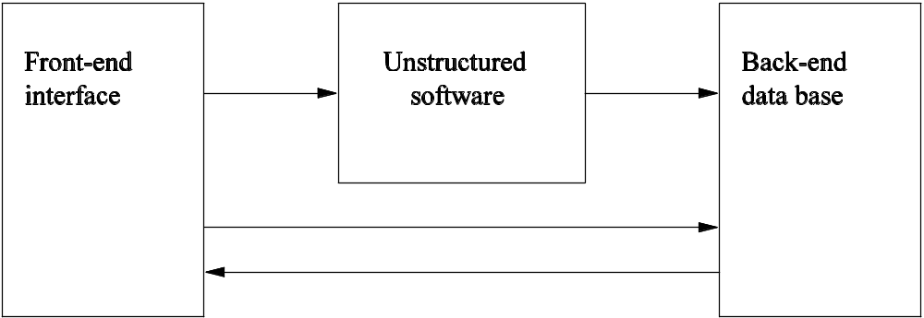
7.5.3 Restructuring Techniques
System Sandwich Approach
  This approach is applied to those software which cannot be restructured with any hope, but need to be retained for their outputs.
  As illustrated in Fig. 7.11, write a new front-end interface and a new back-end data base so that:
    it is easy to interface with the program; and
    the program’s outputs are recorded in a more structured way.
Figure 7.11: System sandwich approach to software restructuring.
The arrows represent the flow of data and/or commands.
Notes:
Handouts

Slide 60
7.5.3 Restructuring Techniques
Clustering Approach
  Software modularization is an important design step.
  A program can be remodularized in two ways.
    System level remodularization
      This is a top-down approach.
      Partition the program into smaller modules, as illustrated in Fig. 7.12.
    Entity level remodularization
      This is a bottom-up approach.
      Group a program’s entities to form larger modules.
Notes:
Handouts

Slide 61
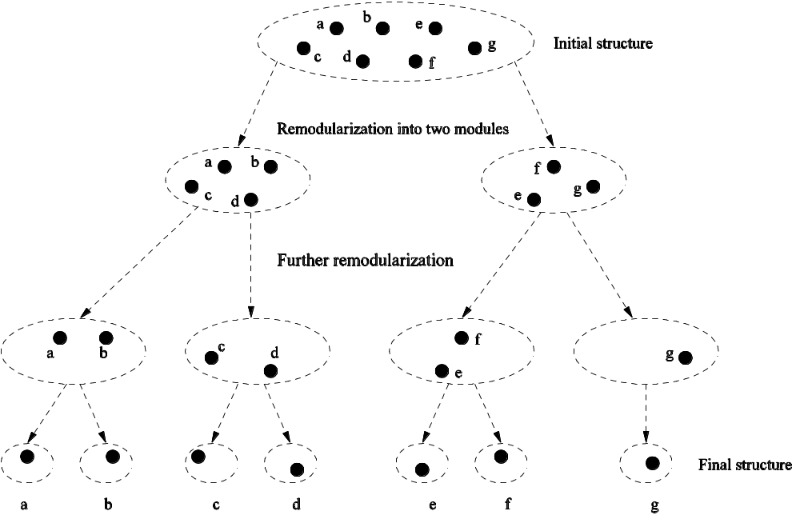
7.5.3 Restructuring Techniques
Figure 7.12: Illustration of system level remodularization.
Bullets represent low level entities.
Dotted shapes represent modules.
Arrows represent progression from one level to the next.

Slide 62
7.5.3 Restructuring Techniques
Clustering Approach (Contd.)
  The concept of clustering is key to modularization.
  Clusters are defined as continuous regions of space containing a relatively high density of points, separated from other such regions by regions containing a relatively low density of points.
  Modularization is defined as the clustering of large amount of entities in groups in such a way that the entities in one group are more closely related, based on some similarity metrics.
  While applying the idea of clustering, two factors are taken into account:
    What similarity metrics to consider?
    What clustering algorithm to use?
Notes:
Handouts

Slide 63
7.5.3 Restructuring Techniques
Clustering Approach (Contd.)
  Similarity metrics
    Distance measures
      Euclidean distance
      Manhattan distance
    Association coefficients
      Simple matching coefficient
      Jaccard coefficient
  Examples of association coefficients
    Let x and y be two entities. Let:
      a = # of features present for both x and y.
      b = # of features present for x but not y.
      c = # of features present for y but not x.
      d = # of features not present for both x and y.
    Simple matching coefficient: simple(x, y) = (a + d)/(a + b + c + d).
    Jaccard coefficient: Jaccard(x, y) = a/(a + b + c).
Notes:
Handouts

Slide 64
7.5.3 Restructuring Techniques
Clustering Approach (Contd.)
  Clustering algorithms: three broad techniques applied.
    Graph theoretical algorithms
    Construction algorithms
    Optimization algorithms (aka iterative and improvement algorithms)
    Hierarchical algorithms
      Divisive algorithms (See Figure 7.12)
      Agglomerative algorithms (See Figure 7.13)
    The clustering produced by a hierarchical algorithm can be visualized in a dendogram.
      The dendogram representation of the hierarchy in Fig. 12 has been shown in Fig. 7.14.
Notes:
Handouts

Slide 65
7.5.3 Restructuring Techniques
Clustering Approach (Contd.)
  The general structure of an agglomerative algorithm
IF there are N entities, begin with N clusters such that each
cluster contains a unique entity.
Compute the similarities between the clusters.
2. WHILE there is more than a cluster
DO
Find the most similar pair of clusters and merge them into a single cluster.
Recompute the similarities between the clusters.
END
Notes:
Handouts

Slide 66
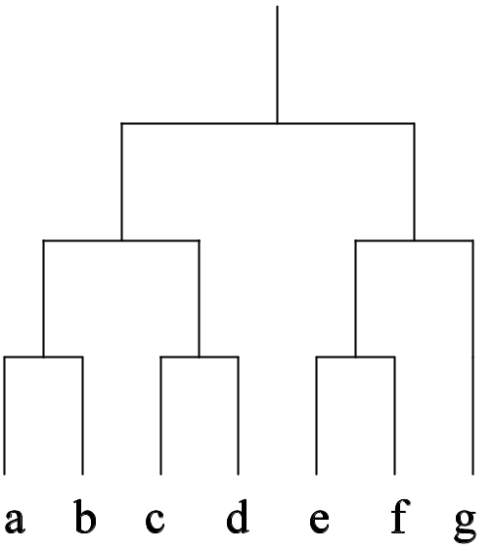
7.5.3 Restructuring Techniques
Figure 7.14: Dendogram
representation
of Fig. 7.12.
Figure 7.12: Illustration of system level remodularization.
Bullets represent low level entities.
Dotted shapes represent modules.
Arrows represent progression from one level
to the next.

Slide 67
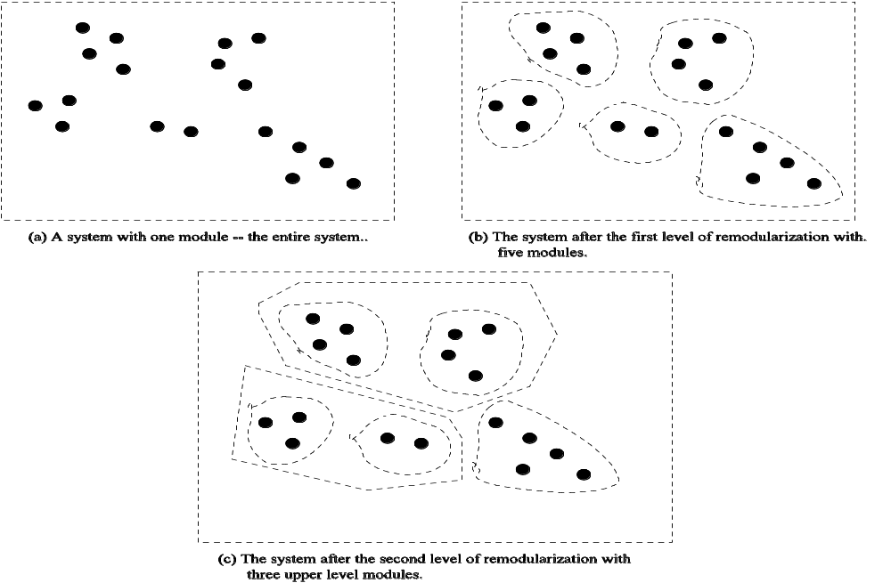
7.5.3 Restructuring Techniques
Figure 7.13: Illustration of entity level remodularization.
Bullets represent low level entities.
Dotted shapes represent modules.

Slide 68
7.5.3 Restructuring Techniques
Program Slicing Approach (Explained in Chapter 4)
  Two kinds of program slicing
    Backward slicing: The set of statements that can affect the value of a variable at some point of interest in a program is called a backward slice.
    Forward slicing: The set of statements that are likely to be affected by the value of a variable at some point of interest in a program is called a forward slide.
  A key idea in program slicing
    Identify and extract a cohesive subset of statements from a program.
  Therefore, if a module supports multiple functionalities, a portion of the code can be extracted to form a new module.
  Large functions can be decomposed into smaller functions by means of program slicing to restructure programs.
Notes:
Handouts

Slide 69
7.6 Summary
General Idea
Activities in a Refactoring Process
Formalisms for Refactoring
More Examples of Refactoring
Initial Work on Software Restructuring
Notes:
Handouts

